Slide 1
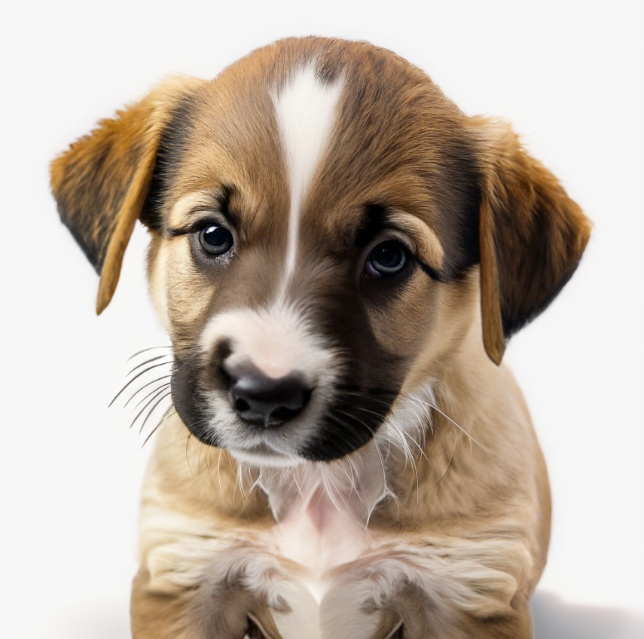
Predicting Pet Adoption Speeds
W207 Summer 2023
Lucy, Nicole, Bailey, Alberto, & Erik
Project Repository Link: https://github.com/UC-Berkeley-I-School/mids-207-final-project-summer23-Rueda-Sambrailo-Herr-Liu-Kuehl
Notes:
[Bailey]
Today, we’re going to be describing our machine learning methodology for predicting pet adoption speeds.
Our team consists of Lucy, Nicole, Alberto, Erik, and Bailey, and we are passionate about promoting adoption.

Slide 2
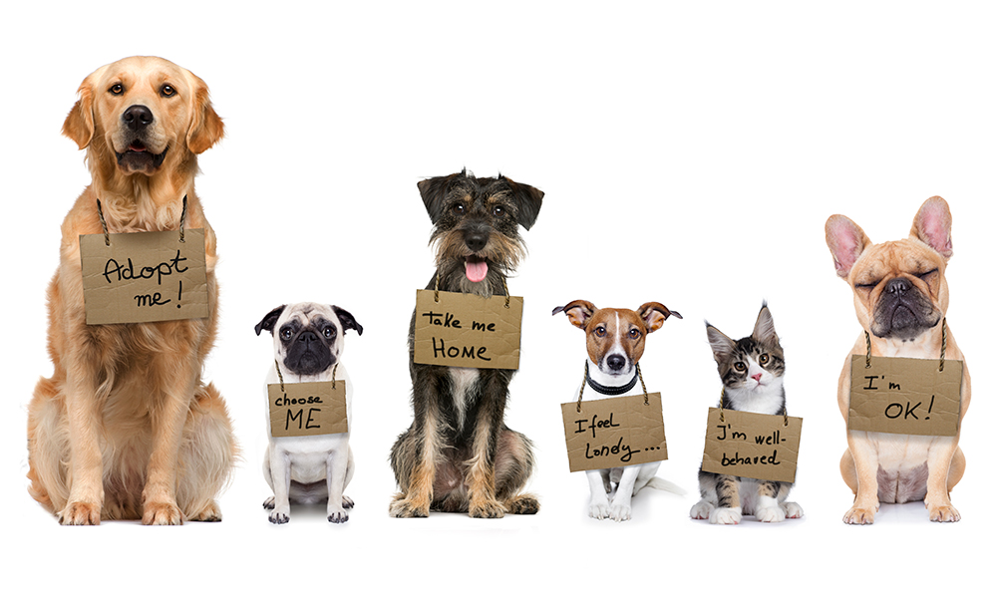
Pet Adoption culture
Notes:
[Bailey]
Pets are a familiar and heart-warming concept across the globe.
And While some countries opt to keep their furry friends outside, many countries, including the US, traditionally prefer to keep their pets in their homes with them.
With this concept of owning pets also comes the concepts of animal shelters and adoption.

Slide 3
Motivation: Animal illness and euthanization in shelters
6.3 million
pets are surrendered to US animal shelters, annually
250%
spike in adoption rates in early-mid 2020 (COVID-19)
1.5 million
dogs and cats in shelters get euthanized, annually
Notes:
[Bailey]
According to research conducted by the World Animal Foundation, 6.3 million pets across the globe (usually cats and dogs) get surrendered to animal shelters each year.
In 2020 when the covid-19 pandemic hit, the Relative Search Volume ratio (which indicates people looking to adopt) increased by nearly 250% across the world.
While this number seemed promising for increasing adpotion, these rates were not sustainable as the pandemic progressed because of the challenges it brought for many people.
For example, many people lost their jobs which supported them financially to feed and care for their pets.
Additionally, many veterinary clinics were not open for new appointments, which caused extremely high demand for pet care services and delayed pet care for many animals.
Not only that, but pets already inside of shelters were also experiencing delayed pet care, which led to contracting and spreading some fatal illnesses within shelters
These factors led to many adopted animals being re-surrendered into shelters.
Today, there are still recorded 1.5 million dogs and cats being euthanized in shelters each year in the United States alone.
Thus, it is extremely important for the health of our animals and for the adoption cycle that animals in shelters get adopted promptly before illnesses or euthanization can occur.

Slide 4
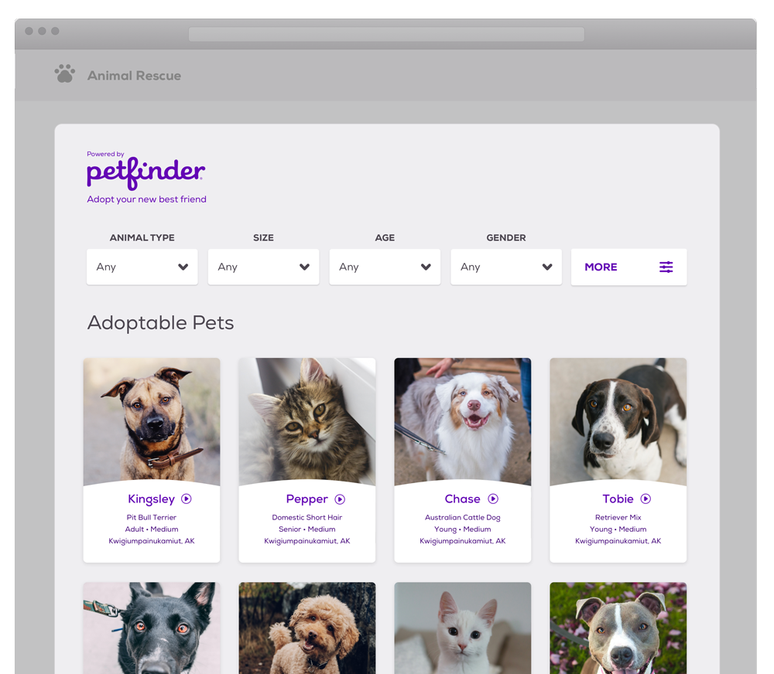
Objectives and Research Questions
Research Objective: Can we use machine learning to predict adoption speed?
Secondary Question: Can we use those predictions to advise shelters on how to increase adoption?
Example Application: Adoption postings
Notes:
[Bailey]
Motivated by this problem, our team was interested in looking into the characteristics of pets that get surrendered to shelters.
Specifically, we wanted to use this information to create a model tht could accurately predict how fast a pet will get adopted given certain metadata.
As a secondary goal, we wanted to learn which specific characteristics typically lead to faster adoption rates.
An exciting application of this work would be to use the information to advise shelters on how they should tailor their adoption listings to promote adoption.
This would hopefully help to increase adoption rates for pets that have historically taken a long time to get adopted

Slide 5
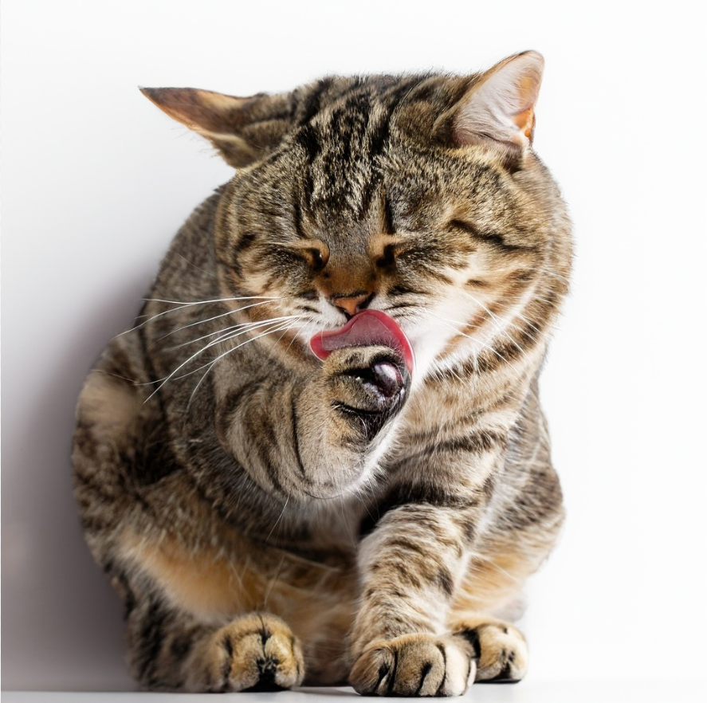
Data:
Overview
PetFinder.my Adoption Prediction Dataset (Kaggle)
Type (Source)
Size
Total
Features
Key Features
Pet Profile Features
Tabular
(14993, 24)
24
Type, Breed, Age, Gender, Health, State (location)
Adoption Speed
Pet Image Metadata
JSON (Google Vision API)
14652 pets
14
Face Annotation, Label Annotation, Image Properties
Pet Description Sentiment Analysis
JSON (Google NL API)
14442
7
Sentiment Score, Sentiment Magnitudes, Languages
Notes:
[Lucy - ~35 seconds]
To address these goals, our models used the PetFinder.my Adoption Prediction dataset from Kaggle
This data consists of pet adoption listings collected from a leading animal welfare platform in Malaysia
We integrated all of the available data sources into modeling:
Tabular pet profile features with [labels for pets’ state, color, and breed]
Metadata from pet profile images generated by Google’s Vision API, and
Sentiment Analysis of pet tprofile descriptions generated by Google’s natural language API
We also integrated median state income and total state population features for pets’ locations
As Bailey described, our baseline model will seek to predict the pet’s adoption speed, which is a categorical feature in varying increments of days, weeks, and month intervals

Slide 6
Data:
Pipeline
Raw tabular data
Parse sentiment & image metadata
Updated tabular data
Train/test split
Tabular EDA
Image EDA
Sentiment EDA
Feature Engineering & Selection
Text: Embeddings
Nominal/ordinal: Binary/OH Encode
Numeric: Standardize
Baseline Model
Model Development & Performance Metric Selection
Model Evaluation
Notes:
[Lucy - realistically, 40-45 seconds as is, but we can absolutely cut it down!]
We designed/structured our data pipeline to develop in-depth understanding of the range of features in our raw data and pre-process it appropriately for our multiple models.
First, we parsed the sentiment and image JSON files before merging it with the tabular data and performing the train/test split
then we performed individual EDA on subsets of the combined data [so that we could develop better domain knowledge about each source]
Next, the feature engineering and selection process was fairly complex and time-consuming. Our focus here was on [feature importance/meaning?,] and choosing the appropriate standardizing and encoding methods for input into different models
After implementing our pre-processing approach, our initial modeling stage experimented with subsets of features based on data type, source, and domain relevance to determine the optimal input for model performance [through evaluation ]

Slide 7
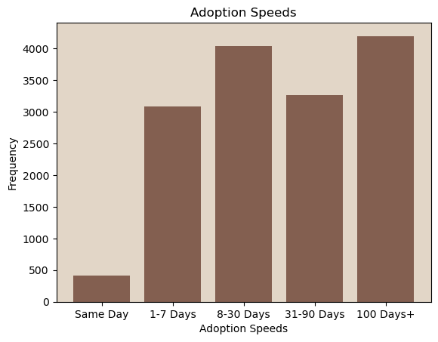
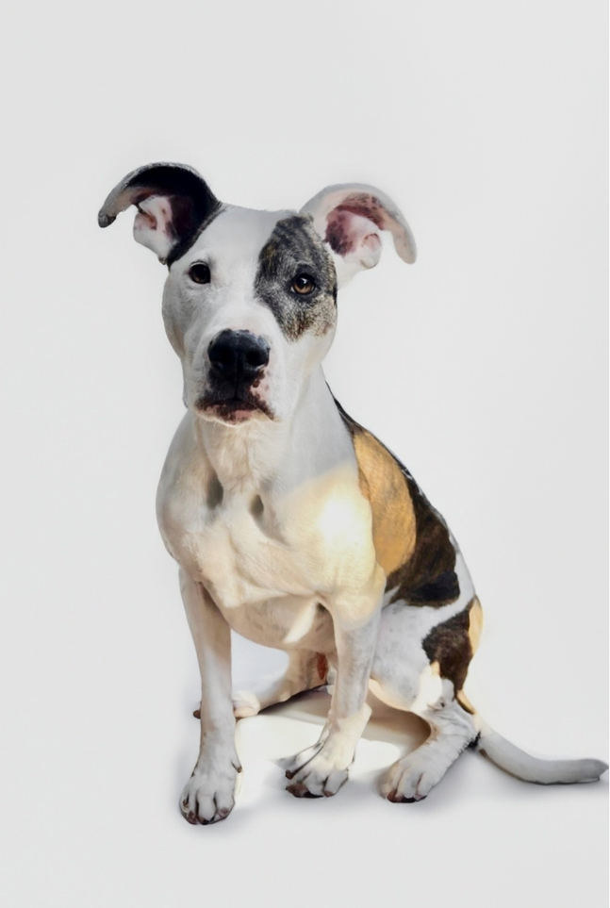
Data: Summary Stats
I was a
‘Same Day’ rescue!
Notes:
[Erik] (10s)
To give a quick summary of our data.
Here we are showing the distribution of our labels
which represent the adoption speed of a pet.
As can be seen, there is some imbalance which we will address in engineering.

Slide 8
Data: Summary Stats
Median Adoption Speeds
faster for. . .
than . . .
cats
dogs
long-haired dogs
short-haired dogs
specified name
(Miu Miu)
unspecified
(kitten)
dog of specified breed
mixed breed
black cat
black, yellow & white cat
Notes:
[Erik] (20s)
We performed extensive EDA , and just wanted to highlight some of the findings.
looking at median adoption speeds
cats were adopted faster than dogs
having specified details like name and breed were helpful
and superstitions around black cats, did not seem to have an affect on adoption speed.

Slide 9
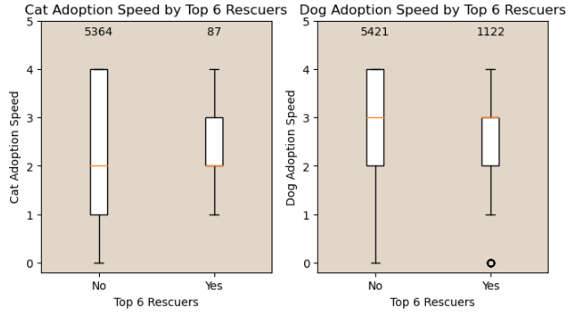
Data: Summary Stats
Pet Rescuers
4,800
Rescuers
~12,000
Adoption Records
6
Rescuers
1,200+
Adoption Records
Notes:
[Erik] (30s)
Another interesting feature of the dataset
was the ID of the Rescuer.
the Train dataset had
4,800 unique “Rescuers”
across 12,000 adoption records.
However, 6 rescuers accounted for 1,209 of those records.
—CLICK—
A box plot reviewing these doesn’t show anything profound.
which was a consistent theme throughout the entire EDA process.
there were no glaring correlations between a given feature and the labels.
Any findings were very subtle.

Slide 10
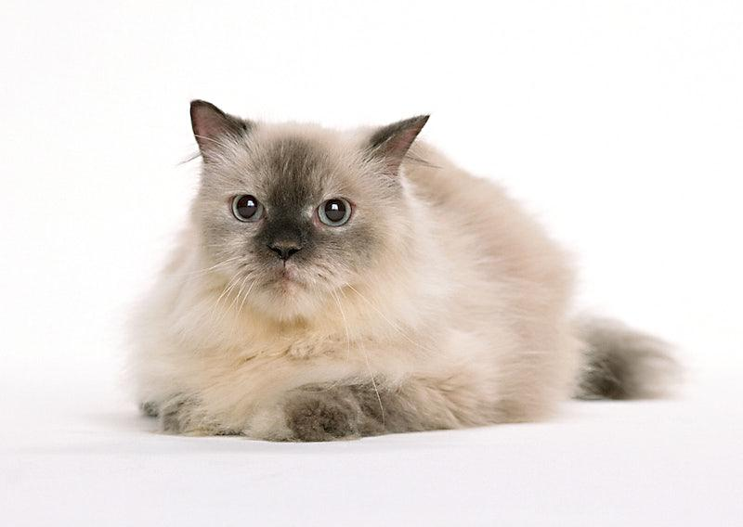
Data:
Feature
Engineering
Feature Additions
RescuerCount (qty of rescues)
State Population & Median Income (for adoption locations)
Breed Groups (by American Kennel Club)
Guessed Age (age was likely guessed)
Feature Transformations
Binning
Binary
Encoding
Multi-Hot Encoding
Standardize
Age
Quantity
Breeds
State
Colors
Gender
Age
Fee
Addressing Nulls
Re-classifying & Balancing Labels
(Adoption Speed)
Notes:
[Erik] (40s)
in attempt to find more profound explanations for adoption speed, we created numerous additional features. Just to highlight a couple examples here:
Number of adoptions by rescuer
population and median income for adoption locations
grouping breeds
we also built features to quantify the integrity of the data.
After additions we transformed features in various ways:
binning
binary, multi & one-hot encoding
and standardization as necessary for models
luckily our dataset was fairly clean, so null values were minimal.
lastly to address the imbalance of our labels,
we combined classes to leave us with with 4 total
and then downsampled to have training balanced.

Slide 11
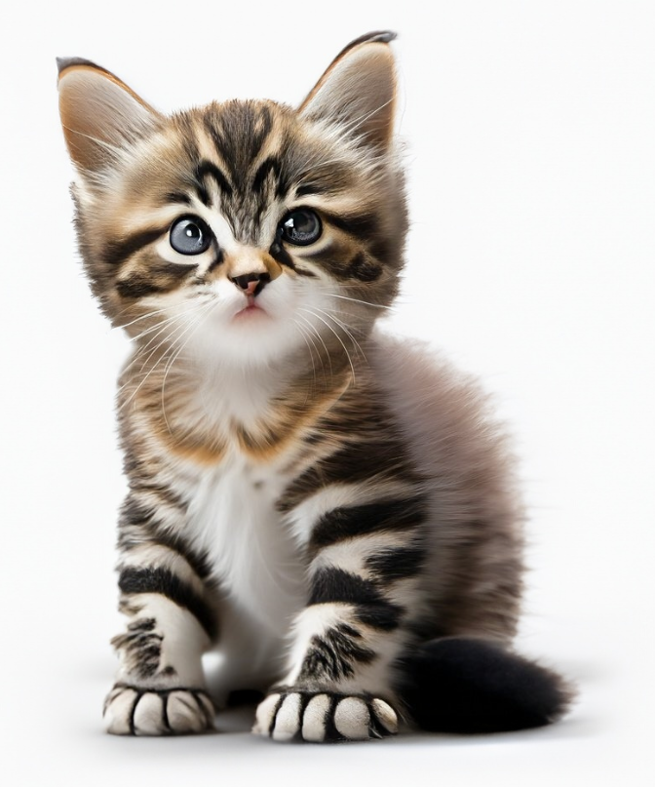
Modeling Approach
Baseline model: Zero Rate Classifier
Route A
Route B
Decision Trees
FF Neural Network
TabNet
Decision Tree Classifier
Ensemble Boosting XGBoost
Text data Embeddings
Numeric or categorical data
Voting Ensemble
Notes:
[Alberto]
In terms of modelling, we started with a Baseline model which is the Zero Rate Classifier => Always predicts the largest class
We go down two different routes
Route A Decision Trees
Rationale: Tree-based models tend to perform the best on medium-sized tabular datasets
Decision Tree Classifier
Ensemble Methods
Boosting = XGBoost (for many its the king of decision tree ensembles)
Route B - Deep Neural Networks. Two architectures:
Feed Forward Neural Network: Three models in total =>
One model with numeric data alone, other with embeddings alone and one with everything combined
Transformer architecture with the numeric and categorical data only
Specifically we used Google TabNet which is available in Pytorch
Motivation: Has shown to outperform Trees in some datasets
In order to combine the models => Voting ensemble of models
Hard voting: Plurality voting
Soft voting: Averaging of class probabilities

Slide 12
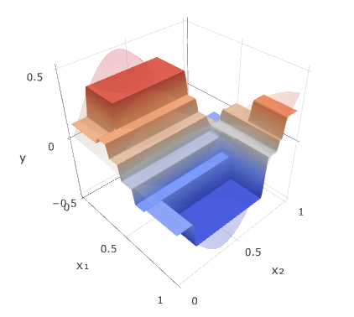
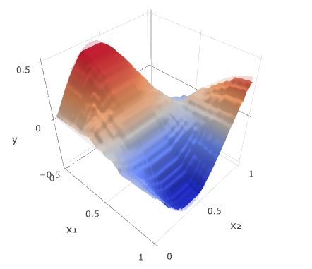
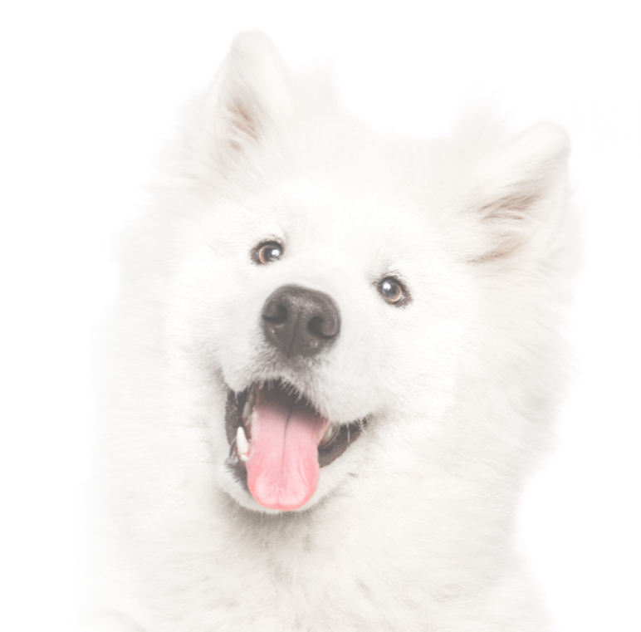
Decision Tree vs. XGBoost
Single Decision Tree
XGBoost
one tree
high feature influence
100’s of trees
very prone to overfitting
source: https://arogozhnikov.github.io/2016/06/24/gradient_boosting_explained.html
Notes:
[Erik] (30s)
I am going to speak to XGBoost model parameter tuning. . .
but first wanted to highlight differences between Decision Tree and XGBoost
these visuals depict sample comparisons between the two at predicting a simple 2-feature function
both are based on decision trees, but required different tuning.
For decision tree,
because it is a single tree, tuning was focused on depth of tree and feature selection
for XGBoost,
because trees are numerous, cutting features provided negligible benefits.
Tuning was more to combat overfitting.

Slide 13
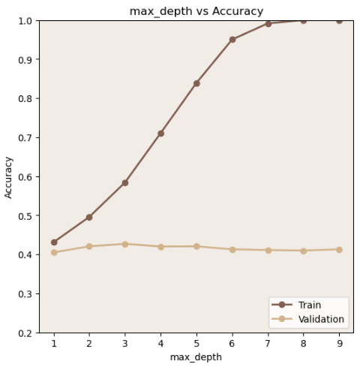
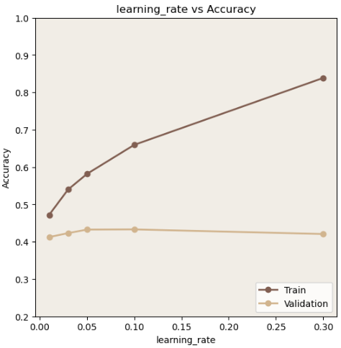
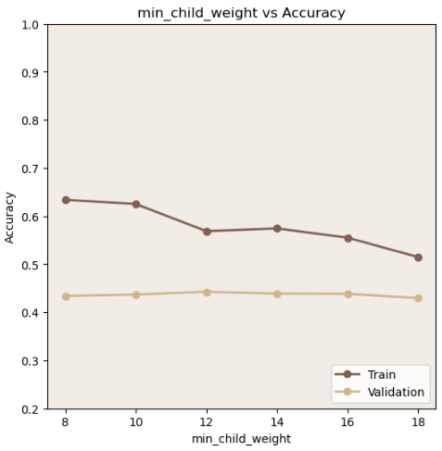
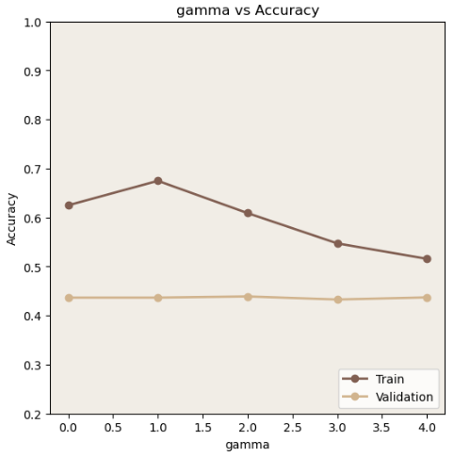
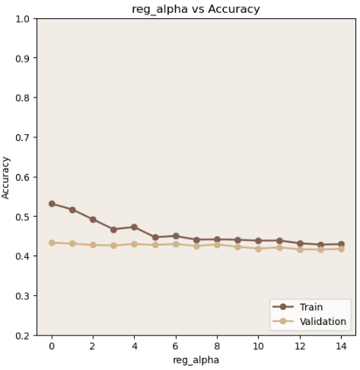
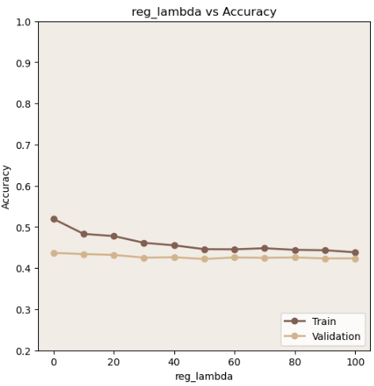
XGBoost: Model & Hyperparameters
max_depth
learning_rate
min_child_weight
gamma
alpha
lambda
Notes:
[Erik] (50s)
These plots demonstrate the steps taken,
and some of the parameters used,
to tune the model for regularization
For the first plot,
we tested a range of max_depth values and their affect on train and validation accuracy.
We selected a value and then tested the next parameter, learning_rate.
As you can see here, with each selected parameter value we were able to achieve a regularized model.
to speak to some of the other hyperparameters listed here:
min_child_weight - Min child weight makes sure a leaf has enough weight.
gamma - Gamma makes sure we are not splitting a node such that the overall gain from parent to children is very low
alpha & lambda - L1 & L2 regularization

Slide 14
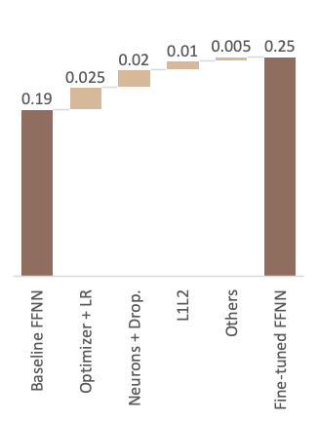
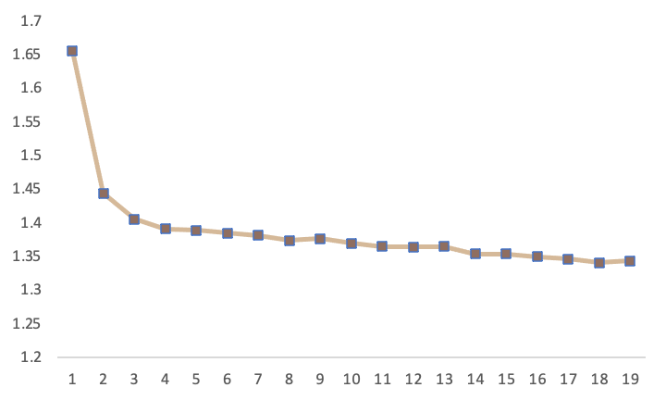
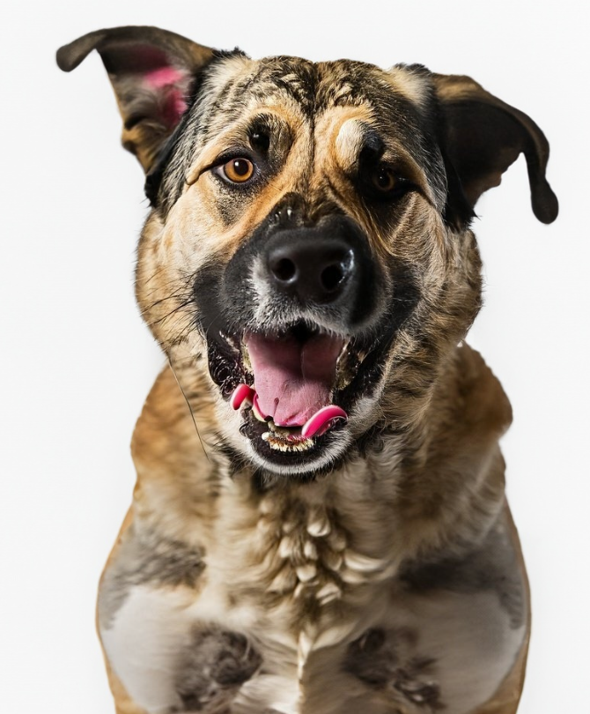
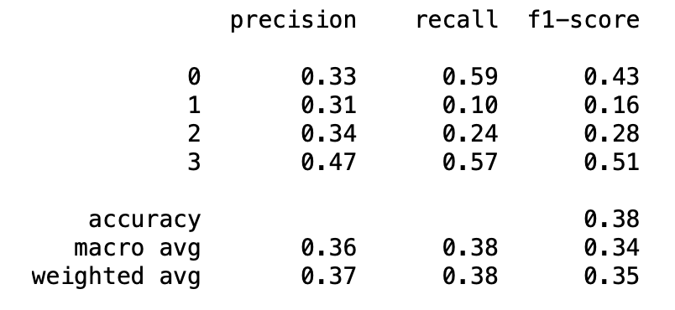
Deep Neural Networks - Architecture & Hyperparameters
Feed-Forward NN (w/out text data)
TabNet (w/out text data)
Weighted F1-Score (val set)
Validation loss
Voting Ensemble (FFNN + TabNet)
❌ Features, activation function, batch normalization, weight decay
Notes:
[Alberto]
Recap: Two different architectures within Deep NN, FF and Transformers. Within FFNN 3 models depending on the type of inputs
Feed-forward neural network (without text data)
Switching to Deep Neural Networks, the motivation for doing FF was a tweet from Sebastian Ratschka quoting a paper saying that a cocktail of regularization techniques performed on average better than XGBoost on tabular data
We tried many of these techniques and although the regularizations improved performance, it was very far from being a silver bullet
You can see on the left hand side => things that worked:
Optimizer: SGD with 0.3 Nesterov momentum with a LR of 0.0025
Adam and AdamW did not generally work
Neuron: Increasing the number of neurons in 2 layers ((32/16 to 64/32) plus two dropout layers of 0.25
More layers/neurons => no impact
L1L2 regularizartions: Only in the kernel, no activity_regularizer and bias_regularizer
Best was L1 0.001 and close to zero for L2
Others:
EarlyStopping with 5 epochs of patience
Batch size from 32 to 16
What did not work
Batch normalization, weight decay
Different features
Turning to Transformers top right chart
Impressive thing it took 5 times fewer epochs to converge to a better result than the FFNN
We tried Different settings:
Surprisingly, Adam with a StepLearningRate was the best combination (as opposed to SGD)
learning_rate 0.001, program to decrease the learning rate after 10 epochs
Activation function or masktype for selecting features: Entmax (instead of sparsemax) which seems worked better than softmax
Lastly, on voting Ensemble:
In order to combine the models, we tried hard and soft voting
Very rewarding because the combination of FFNN only with embeddings + TabNet with numeric features performed better than any model standalone
You can see bottom right

Slide 15
Summary of Results
 |  | Test Set: weighted-F1 score
Baseline Majority Predictor | 0.10 | 0.12
Decision Tree | 0.38 | 0.36
XGBoost | 0.41+ | 0.41+
Feedforward Neural Network | ~0.35 | ~0.30
Transformers: TabNet | 0.29 | 0.29
Ensemble: FFNN + TabNet + XGBoost | ~0.40 | ~0.40
Val Set:
weighted-F1 score
Test Set:
weighted-F1 score
Notes:
[Nicole]
Used weighted F1 SCORE to evaluate the model
f1 score includes impact from both false positives and false negatives, providing a more balanced measure than accuracy
Used weighted f1 to account for class imbalance
To summarize the various models we explored
Majority predictor baseline model had an f1 score of 0.12 on test set
Decision tree was better than baseline
XGBoost was the best model among all, yielding an F1 of over 0.40
We tried various combinations of features for feedforward neural network: even the best one doesn’t beat XGBoost (which i’ll discuss later)
Finally, Transformers TabNet is currently below XGBoost and some NN configurations
our ensemble achieves F1 scores close to XGBoost, given XGBoost is the dominant contributor to the ensemble

Slide 16
Key Takeaways from Models
FFNN: suffering from overfitting and feature interference
Val Set:
weighted-F1 score
Test Set:
weighted-F1 score
FFNN (numeric features only) | 0.37 | 0.25
FFNN (text description only - embedding) | 0.31 | 0.33
FFNN (text embeddings + numeric) | 0.34 | 0.16
Ways to improve model performance
Feature engineering
Model depth and width
Regularization
Learning Rate and Optimizer
Notes:
[Nicole]
We learned a lot from the exercise and i’ll just highlight a few key takeaways
FFNN: as we included more features, the model sometimes performed worse. This is due to
Overfitting with increased complexity, and
Feature interference as noise overshadows more meaningful features
We were able to improve our models via these mechanisms below
Feature engineering: e,g, extracting new features
changing model depth and width
Fine tuning the drop out layers or L1/L2 regularization
Adjusting the learning rates and optimizer

Slide 17
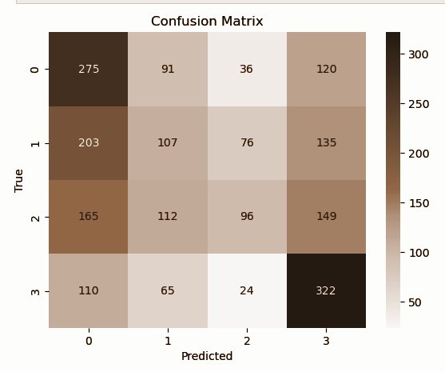
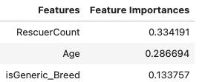
Conclusion
Research Objective: Can we use machine learning to predict adoption speed?
Secondary Question: Can we use those predictions to advise shelters on how to increase adoption?
Information gain ranking from decision tree
Notes:
[Nicole]
So: in conclusion, can we use machine learning to predict adoption speed?
It depends, on the class of the sample. the most important class in this exercise is arguably class 3, which represents pets that haven’t been adopted in 100 days. Based on this confusion matrix on val set from decision tree, the recall for this category is about 62% meaning the model correctly labeled 62% of the true class 3. This potentially helps shelters allocate resources for pets most likely to stay the longest.
Secondly, Can we use those predictions to advise shelters on how to increase adoption?
The 3 most important features from decision tree are presented here on the slide; in reality, the correlation between any of these features alone and adoptionSpeed is pretty small as mentioned by Erik, and we all know correlation is not causation; at this point, we’re not recommending any strategy to this end; but bailey will talk next about future work

Slide 18
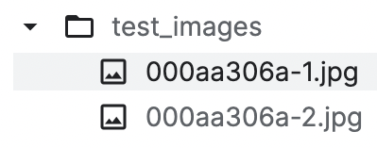
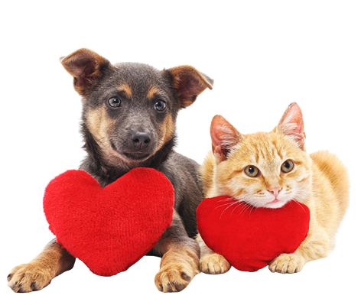

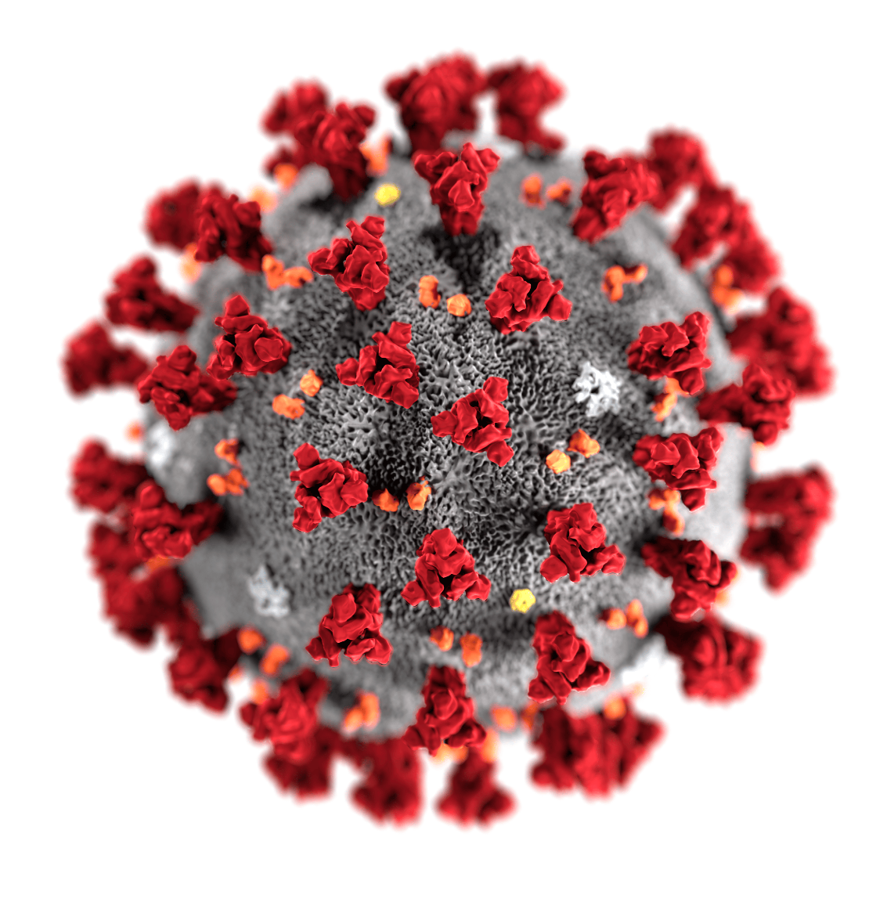
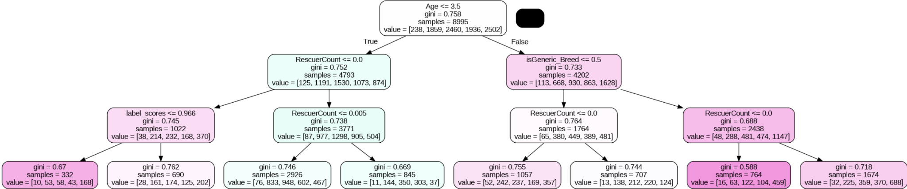
Limitations and Future Work
Limitations
Future Work
Image processing techniques
Collect recent data and include dates / timestamps
Refine key features to use for decision trees
Notes:
[Bailey]
It is important to note that this study has some limitations that likely affected the results Nicole just mentioned
For example, the dataset we used contained several images for each Pet ID that we weren’t able to featurize due to complexity and time constraints.
To address this limitation, we recommend that future work utilize image processing techniques to create more features from the provided images.
Another limitation was related to the dataset itself. First, this competition is from 4 years ago, which means the dataset is from 2019 at the latest. This means the data doesn’t accurately reflect adoption post-pandemic. Second, without exact timestamps of adoption, it’s likely there is some margin of error in our results due to the lack of granularity of the adoption speed variable.
More precise adoption speed data should be used in future work to generate more accurate predictions.
Finally, while we tried using decision trees for feature selection, we found that utilizing only those selected features resulted in decreased accuracy than when we incorporated all available features.
For future work, we would recommend trying decision trees again, but first refining existing features and adding more features by expanding upon the dataset as mentioned earlier.

Slide 19
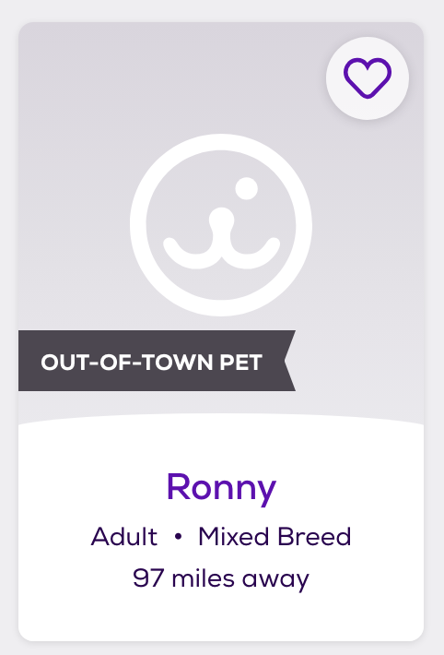
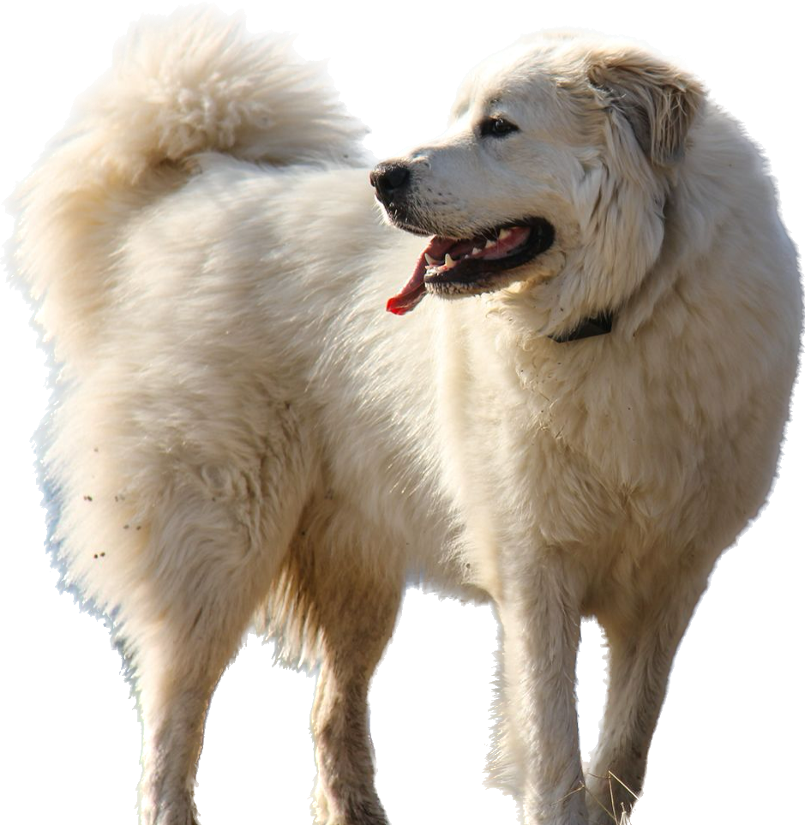

Fairness in ML
Accessibility of data and images (variability in image quality, demographic / geographic representation)
Image processing / Description bias (embeddings, image metadata)
Privacy of veterinary medical records
Impact: Inaccurate recommendations for adoption postings could negatively impact eligible pets.
Notes:
[Bailey]
Finally, we considered potential biases and fairness of our models.
The primary fairness consideration for our project was related to the accessibility of this data, as well as how it was created.
Due to the human involvement in the curation of this data (namely image submission and descriptions), we believe our model's predictions were susceptible to bias.
This is because the images submitted for this dataset are inherently biased on some threshold of socioeconomic status, given the financial barrier of having access to a camera and the internet.
Additionally, our models might not generalize well for pets in other countries, given that this data comes from Malaysian pets.
Other fairness considerations include image processing biases and privacy.
In summary, the impact of perpetuating the unfairness and biases mentioned could be detrimental to many pets for this application, so it’s important to address these concerns for future work.

Slide 20
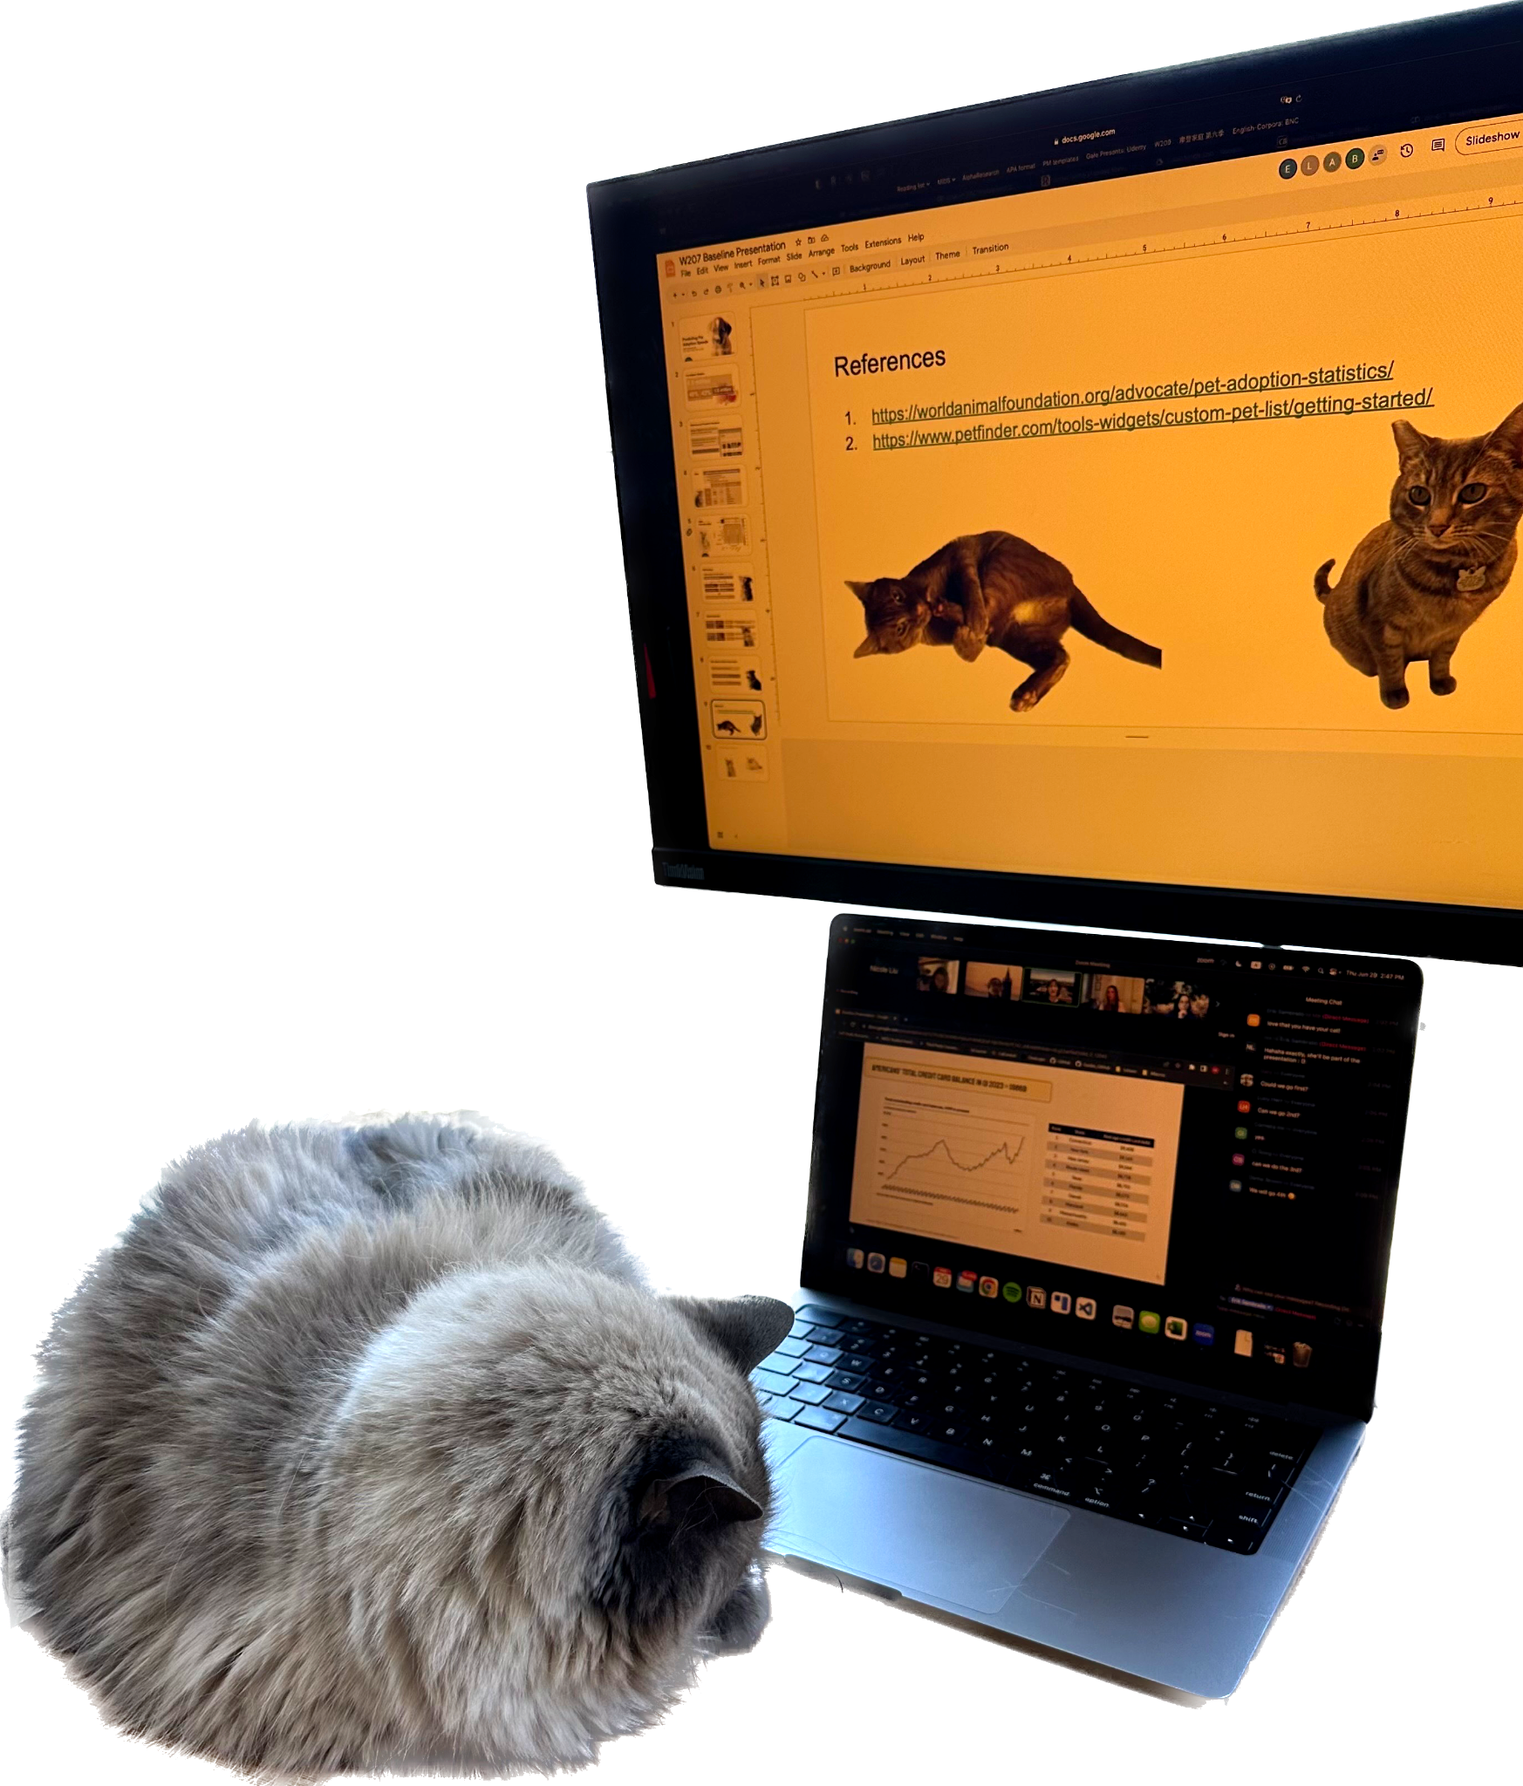
Contributions
All team members worked on all stages of the project collaboratively, sharing the work streams in an equal and effective way
Data processing / Feature Engineering
Bailey worked on the image files, Nicole on the sentiment files, Erik and Alberto split the numeric features and Lucy worked on incorporating additional data and putting everything together
Modeling
Bailey and Erik worked on Decision Trees
Nicole, Lucy and Alberto worked on FFNN and Transformers
Slides
Divided equally according to the previous work done
Notes:
[Bailey]
Finally, here is how our team split up the work.
With that – we’d love to take any questions or comments anyone has. Thank you!

Slide 21
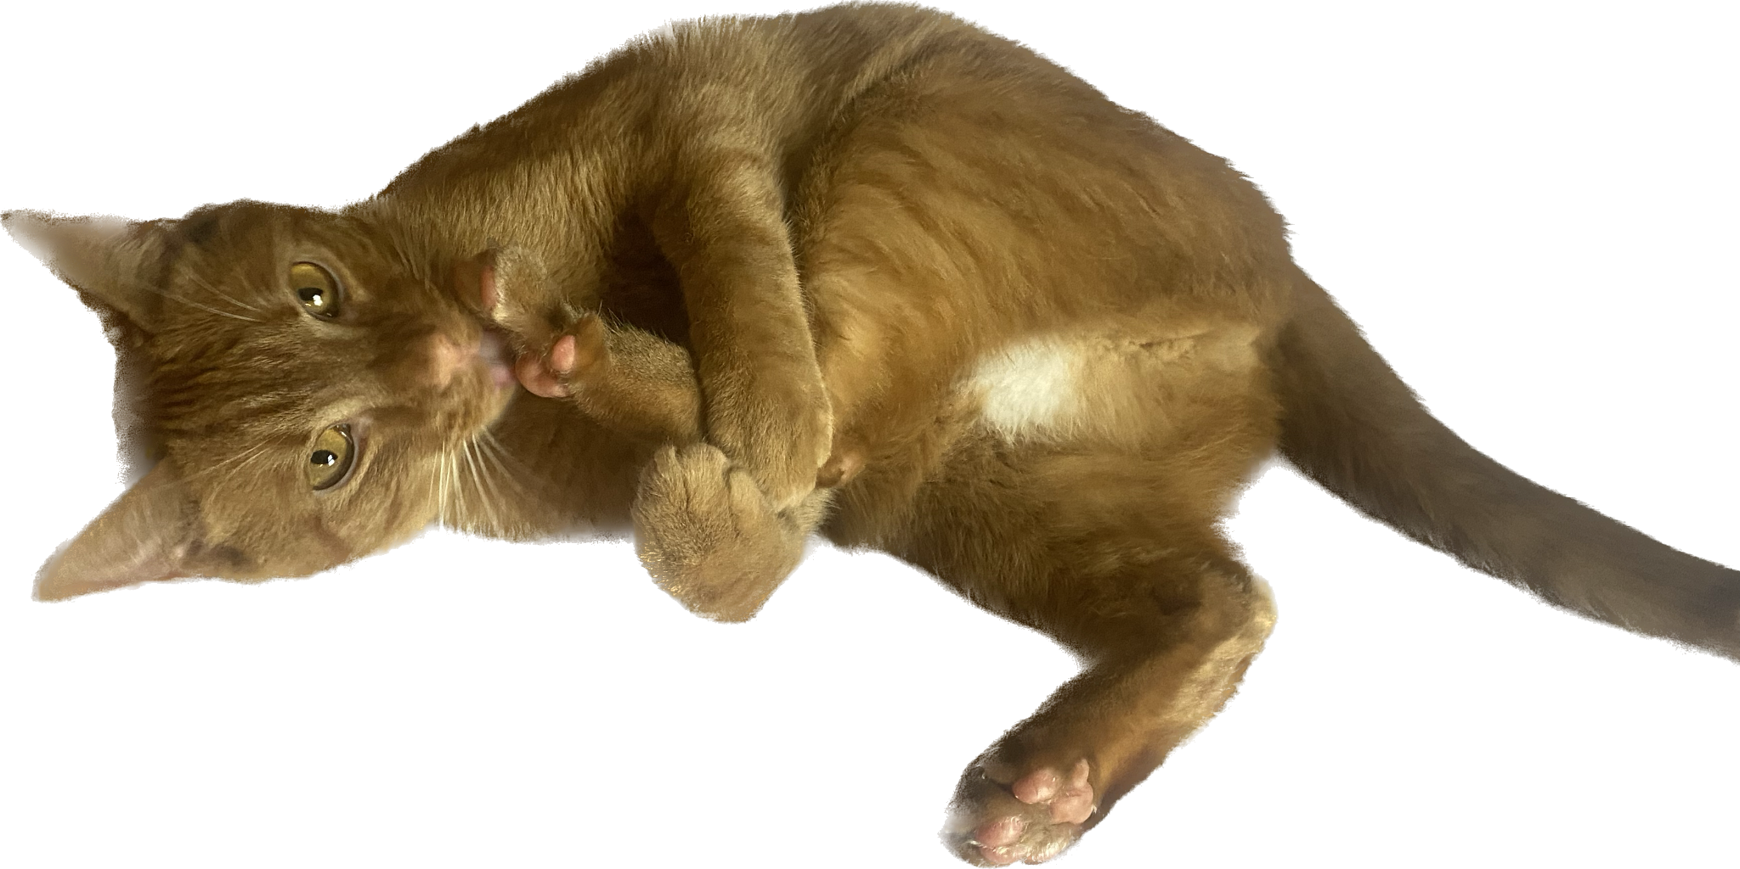
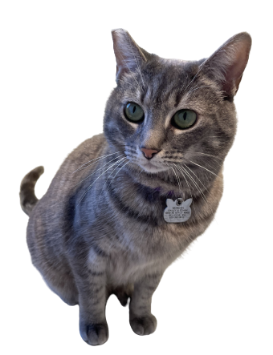
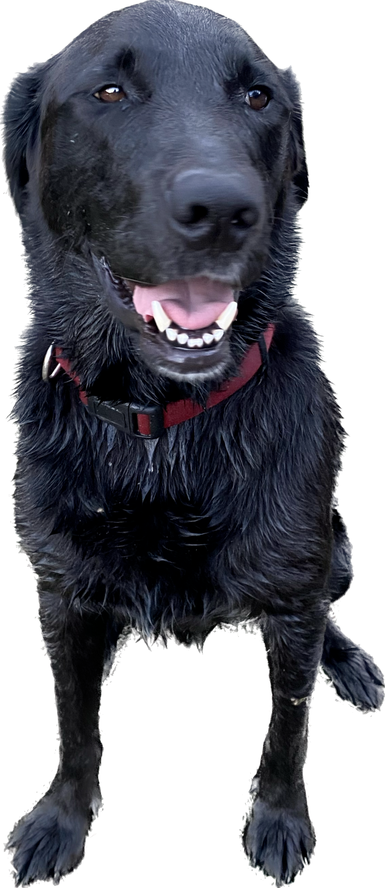
References
Ho, J., Hussain, S., & Sparagano, O. (2021). Did the COVID-19 pandemic spark a public interest in pet adoption?. Frontiers in Veterinary Science, 8, 647308.
Zadeh, A., Combs, K., Burkey, B., Dop, J., Duffy, K., & Nosoudi, N. (2022). Pet analytics: Predicting adoption speed of pets from their online profiles. Expert Systems with Applications, 204, 117596.
https://worldanimalfoundation.org/advocate/pet-adoption-statistics/
https://www.americanhumane.org/fact-sheet/animal-shelter-euthanasia-2/
https://www.petfinder.com/tools-widgets/custom-pet-list/getting-started/
https://www.washingtonpost.com/business/2022/01/07/covid-dogs-return-to-work/
https://raw.githubusercontent.com/MoH-Malaysia/covid19-public/main/static/population.csv
https://storage.googleapis.com/dosm-public-economy/salaries_state_sex.csv
https://www.hhhstopeka.org/adopt
https://www.cleveland19.com/2021/09/27/pandemic-pets-are-facing-euthanization-after-being-surrendered-due-overcrowding/
https://www.kaggle.com/competitions/petfinder-adoption-prediction/discussion/88773
https://www.kaggle.com/c/petfinder-adoption-prediction/discussion/89042

Slide 22
Animal Images for Adoption . . .

